Slide 1
Vehicle Number Recognition Using Existing General Surveillance Cameras
Submitted in the partial fulfillment for the award of the degree of
BACHELOR OF ENGINEERING
IN
Computer Science And Engineering (Artificial Intelligence and Machine Learning)
Submitted by:
DHINESH KUMAR
21BCS10635
Under the Supervision of:
MR. VIJAY BHARDWAJ
Department of AIT-CSE
DISCOVER . LEARN . EMPOWER

Slide 2
Outline
Introduction to Project
Problem Formulation
Objectives of the work
Methodology used
Results and Outputs
Conclusion
Future Scope
References

Slide 3
Introduction to Project
The term "automatic license plate recognition" (ALPR), also known as "automatic number plate recognition" (ANPR), refers to a system that makes use of image processing methods to detect and identify vehicle license plates from pictures or video feeds acquired by security cameras. This examination of the literature looks at the state-of-the-art in ALPR and how it may be used in actual surveillance systems, especially when employing current standard video cameras.
The ALPR technology has several uses in security, law enforcement, parking management, and traffic control.
ALPR is a system that employs image processing methods to identify and recognize car license plates from pictures or video streams acquired by security cameras. In certain areas, ALPR is also referred to as Automatic Number Plate Recognition (ANPR).
Real-time processing capabilities are vital for applications such as traffic monitoring and security. Leveraging the computational power of modern GPUs and deep learning frameworks, our system ensures rapid vehicle number recognition, enabling timely response to critical incidents.

Slide 4
Problem Formulation
The construction of a reliable license plate recognition system for vehicles utilizing current general surveillance cameras is the issue this project attempts to solve.
With an emphasis on boosting security, traffic management, and parking enforcement, the main goal is to automate the process of properly obtaining and analysing license plate numbers from real-time video feeds. Various facets of computer vision, image processing, and system integration are included in the problems to be overcome
Input:real-time video feeds from security cameras placed in strategic locations where license plate identification is needed.
Output:a textual representation of the license plate number created by the precise identification of license plate characters.Relevance of accepted information in relation to databases of registered automobiles, including information on the owner and the vehicle.
Creating an intelligent system that can consistently and precisely identify license plate numbers from active security cameras is the main objective of this project. The system ought to improve safety precautions, improve traffic control, and aid in effective parking enforcement
The project attempts to offer a complete solution for contemporary license plate identification requirements by resolving the aforementioned difficulties and attaining these objectives.

Slide 5
Objectives of the Work
Identifying vehicles: VNR systems can be used to identify vehicles for a variety of purposes, such as traffic monitoring, law enforcement, and security. For example, VNR systems can be used to identify stolen vehicles, vehicles associated with known criminals, and vehicles that are violating the law.
Tracking vehicles: VNR systems can be used to track the movement of vehicles in specific areas. This information can be used to improve traffic flow, investigate crimes, and monitor the movement of vehicles of interest.
Collecting data: VNR systems can be used to collect data on vehicle movements, traffic patterns, and other transportation-related metrics. This data can be used to improve transportation planning and to make informed decisions about transportation policy.
Traffic management: VNR systems can be used to monitor traffic flow and identify traffic violations. This information can be used to improve traffic flow and reduce congestion. For example, VNR systems can be used to identify vehicles that are speeding or running red lights.
Law enforcement: VNR systems can be used to identify stolen vehicles and vehicles associated with known criminals. VNR systems can also be used to investigate crimes and to track the movement of vehicles of interest
Security: VNR systems can be used to control access to restricted areas, such as parking lots, airports, and government buildings. VNR systems can also be used to monitor the movement of vehicles in sensitive areas

Slide 6
Methodology used
Problem Understanding:Define the scope, objectives, and requirements of the license plate recognition system.Identify the areas where surveillance cameras will be deployed and where license plate recognition is needed.
Data Collection:Collect a diverse dataset of license plate images and video frames captured by the surveillance cameras.Annotate the dataset with accurate ground-truth license plate information for training and validation.
Preprocessing:Enhance the quality of captured video frames through techniques like denoising, contrast adjustment, and resizing.Implement lighting normalization to handle variations in lighting conditions.
License Plate Localization:Develop or use pre-trained object detection models (e.g., YOLO, Faster R-CNN) to locate license plates within the preprocessed frames.Extract regions of interest (ROI) containing license plates for further processing.
Optical Character Recognition (OCR):Train deep learning models (e.g., CNNs, LSTM networks) for character recognition using annotated data.Fine-tune models to accurately recognize license plate characters in different languages and fonts.

Slide 7
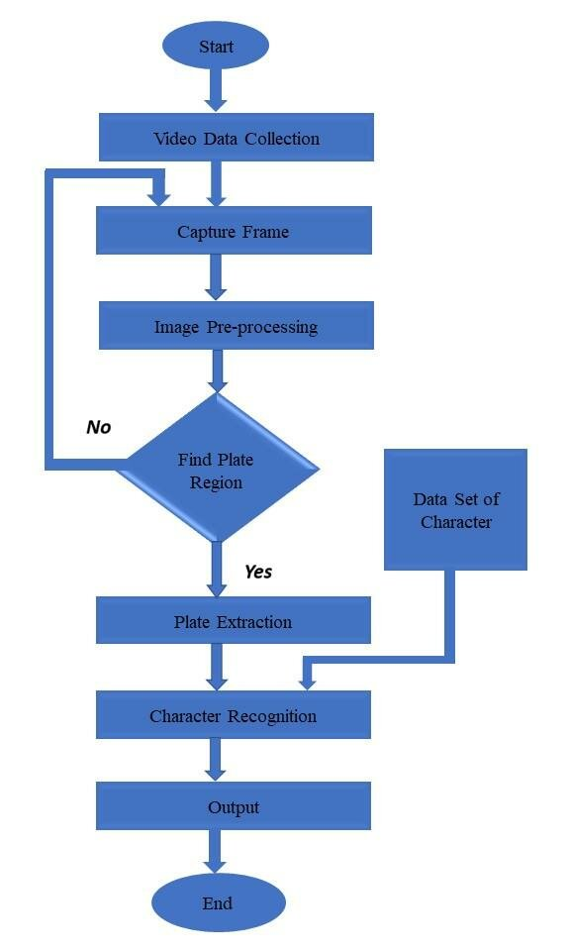
Methodology used

Slide 8
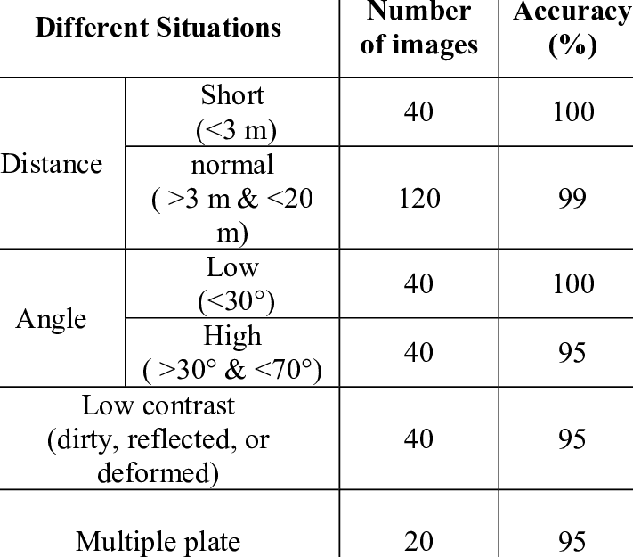
Results and Outputs
We can find the Accuracy and Precision

Slide 9
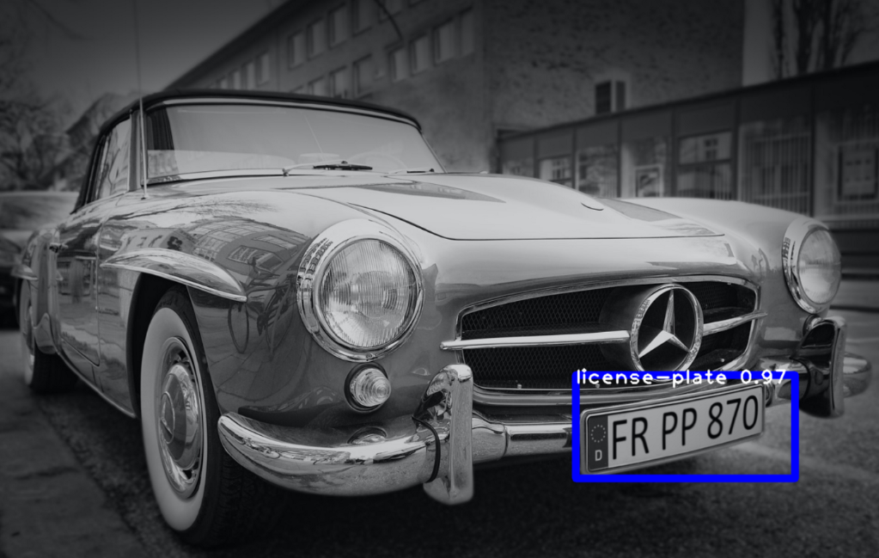
Output
Image Pre-Processing for the visibility

Slide 10
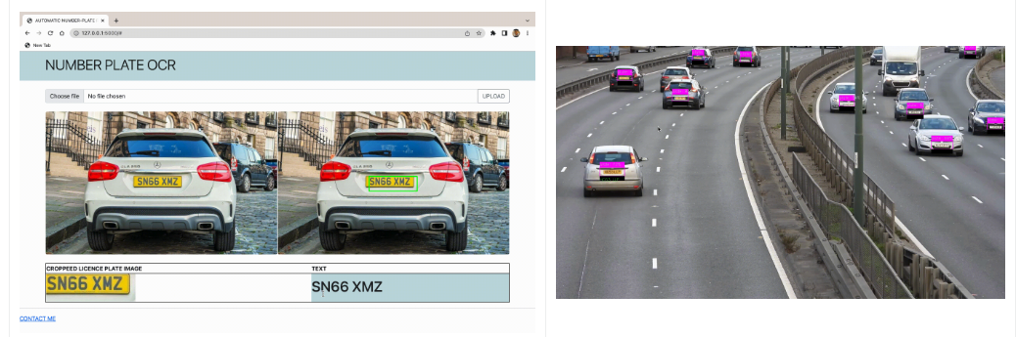
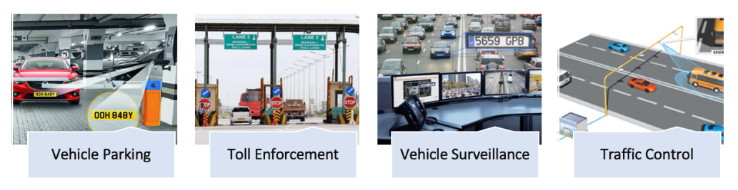
Output

Slide 11
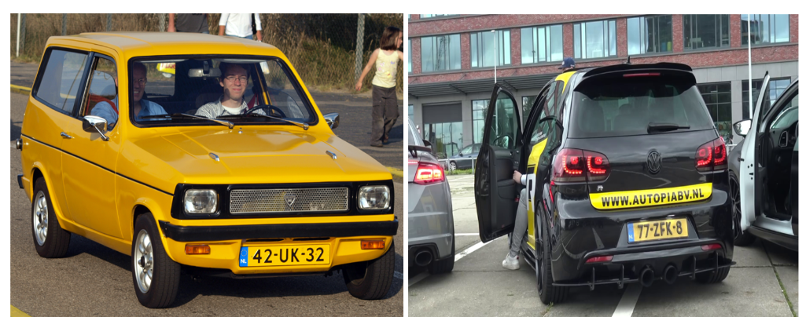
Output

Slide 12
Conclusion
Using current general surveillance cameras to construct a vehicle license plate recognition system is a complex project that has important ramifications for security, traffic control, and overall urban effectiveness
This project intends to transform the way we recognize and manage cars in various situations by integrating cutting-edge technology such as computer vision, deep learning, and real-time processing.
This system aims to accelerate the processes of license plate localization, character recognition, and database integration by tackling issues such changing lighting circumstances and privacy issues
In addition to lowering human mistake rates, automation of these procedures also enables quick responses to security warnings and effective access control in parking garages.
With the increasing importance of software development in today's technology-driven world, the cloud-powered bug tracking functionality project has the potential to significantly improve software development processes, enhance collaboration and communication among developers and stakeholders, and ultimately contribute to the success of software projects.

Slide 13
Future Scope
Vehicle number recognition (VNR) technology has made significant progress in recent years, and it is now used in a wide variety of applications. However, there is still significant room for improvement, and there are many new and innovative ways that VNR technology can be used in the future.
VNR for security: VNR can be used to control access to restricted areas, such as airports, government buildings, and military bases. VNR can also be used to monitor the movement of vehicles in sensitive areas.
VNR for smart parking: VNR can be used to develop smart parking systems that can automatically identify and track vehicles in parking lots. This information can then be used to guide drivers to available parking spaces and to charge them for parking based on the amount of time they spend parked.
Smart cities: VNR systems could be used to manage traffic, control access to restricted areas, and monitor the movement of vehicles in smart cities.
Self-driving cars: VNR systems could be used to help self-driving cars identify other vehicles on the road and to avoid collisions.
Intelligent transportation systems: VNR systems could be used to collect data on traffic patterns and vehicle movements. This data could then be used to improve traffic flow and reduce congestion.
Law enforcement: VNR systems could be used to identify stolen vehicles, vehicles associated with known criminals, and vehicles that are violating the law. VNR systems could also be used to investigate crimes and to track the movement of vehicles of interest.

Slide 14
References
Korrapati, V. S. (2020). "Privacy-Preserving Automatic License Plate Recognition Using Homomorphic Encryption." In Proceedings of the 8th International Conference on Information and Communication Technology (pp. 179-190)
Rida, I., & Mohammed, M. (2020). "Privacy-preserving smart surveillance system using blockchain technology." IEEE Access, 8, 153707-153721.
Wei, W., Liu, Z., & Zhao, X. (2020). "An IoT-Based Smart Parking System for Large Parking Lots." Sensors, 20(19), 5531.
Zhang, K., Zhang, L., & Song, M. (2021). "Vehicle Detection and License Plate Recognition on Low-Resolution Surveillance Cameras for Large Parking Lots." IEEE Transactions on Industrial Informatics, 17(5), 3395-3404.
Jianping Zhou, Yanpeng Jin, Donghai Wang. “A Novel Approach for License Plate Recognition Using Existing Surveillance Cameras”
Md. Shamsul Islam, Md. Rezaul Karim, Md. Khairuzzaman. “License Plate Recognition Using Existing Surveillance Cameras: A Comparative Analysis”

